Slide 1
Comparison Chart of question 3

Slide 2
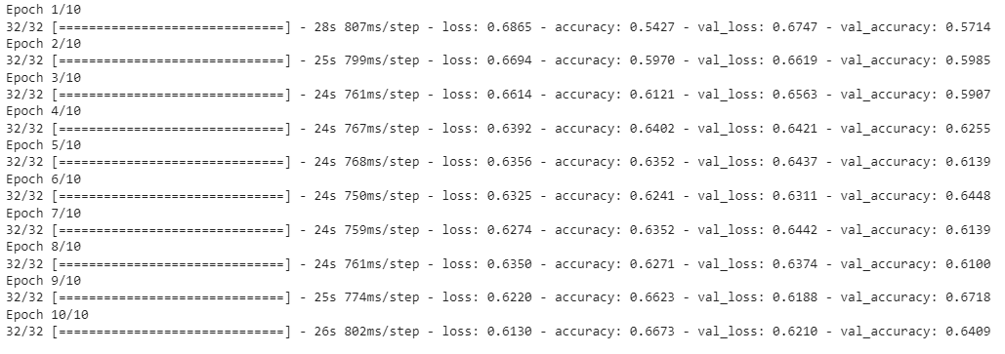
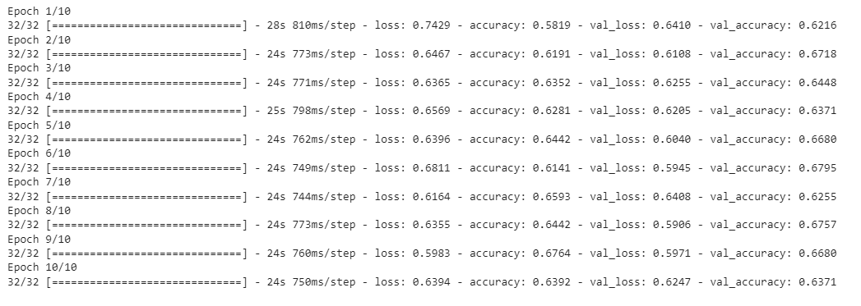
Resnet50 (Original and Augmented data)
Original dataset
Augmented dataset

Slide 3
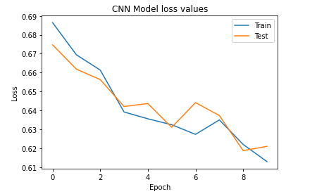
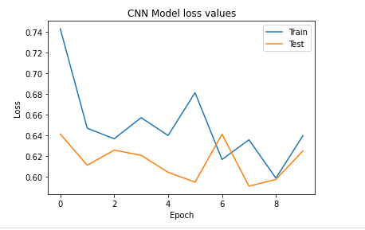
Loss Plots
Original dataset
Augmented dataset

Slide 4
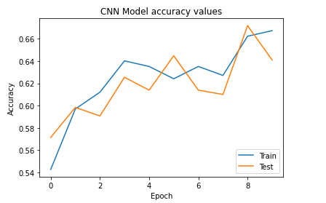
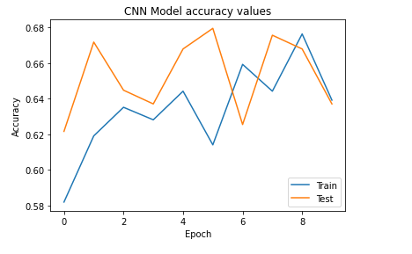
Accuracy Plots
Original dataset
Augmented dataset

Slide 5
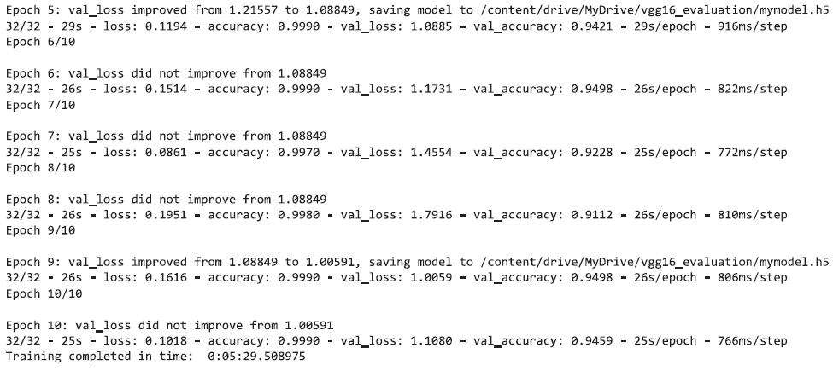
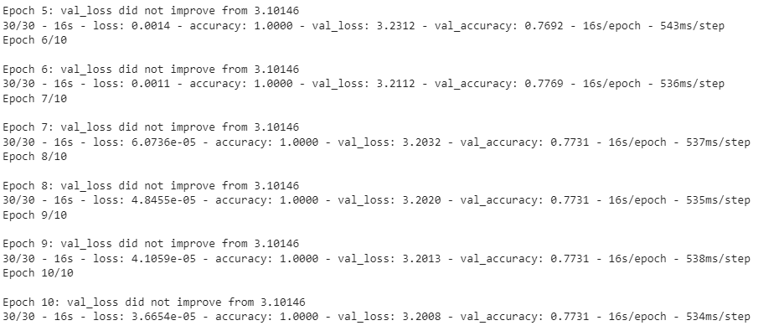
VGG16 (Original and Augmented data)
Original dataset
Augmented dataset

Slide 6
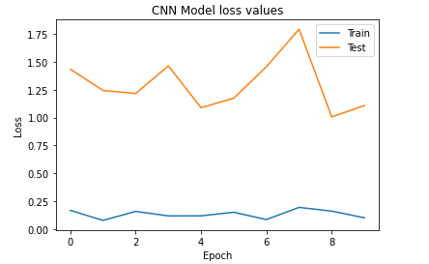
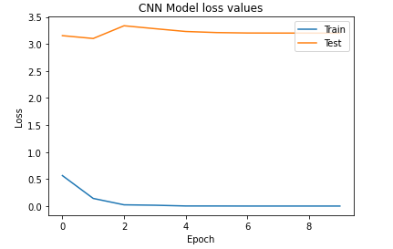
Loss Plots
Original dataset
Augmented dataset

Slide 7
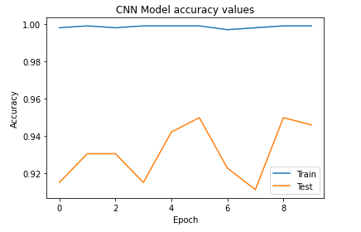
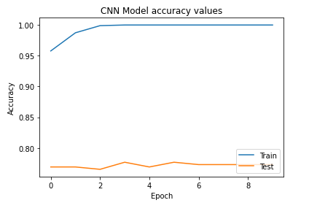
Accuracy plot
Original dataset
Augmented dataset

